Slide 1

USC Housing Mobile Application Project
ISE 515 Engineering Project Management
Team 4.4 : Sami Andari, Diya Shah, Mihir Kavishwar, Rhythm Deo, Guozheng Yang
Notes:
SA

Slide 2

Is your landlord adding unnecessary stress to your student life?
Struggling to furnish your student accommodation affordably?
Ever found yourself with peculiar housemates?
Do online housing reviews align with the reality of your living situation?

Slide 3

Notes:
RD

Slide 4

Mission statement
"Empowering USC students with authentic reviews, effortless roommate matching, and a user-friendly marketplace. Redefining housing, one click at a time."
Notes:
DS

Slide 5
Table of contents
01
02
03
Problem
Introduction
Timeline
04
05
07
06
Budget
OCM
Contingency
Change Control
Scope
Schedule
Budget
Risk & Change
Notes:
DS

Slide 6

Scope
Notes:
DS

Slide 7
SCOPE
USC ID
IOS, Android, Web Platform
Reviews, Roommate Matcher, and Buying/Selling Goods
Student Profile
Advertisements
Images of Products
Notes:
DS

Slide 8

Anticipated Challenges & Constraints
Server Traffic
Inclusive Environment for roommate matching
Genuine Reviews
Data Security
Atleast 5% increase in downloads for every quarter
Notes:
DS

Slide 9
Market size
TAM $16B
All users needing rental assistance
SAM $5.5B
University students needing rental assistance
SOM $8.1M
USC students needing rental assistance
* For reference materials, please see the end of the document.
Notes:
MK

Slide 10
Schedule

Slide 11
Timeline
Oct 30 2023
Jan 2 2024
Feb 21 2024
Mar 21 2024
May 2 2024
July 9 2024
Aug 21 2024
Go Live
Project
Initiation
Project
Plan
Finalized
Begin
App
Development
Alpha
Test
Beta
Test
App
Release
Project
Evaluation
Notes:
Yang
Link for MPP: https://uscedu-my.sharepoint.com/:u:/r/personal/sandari_usc_edu/Documents/DormGrader%20Project%20Schedule.mpp?csf=1&web=1&e=KNKrhj

Slide 12
Work Breakdown Structure
Notes:
RD

Slide 13
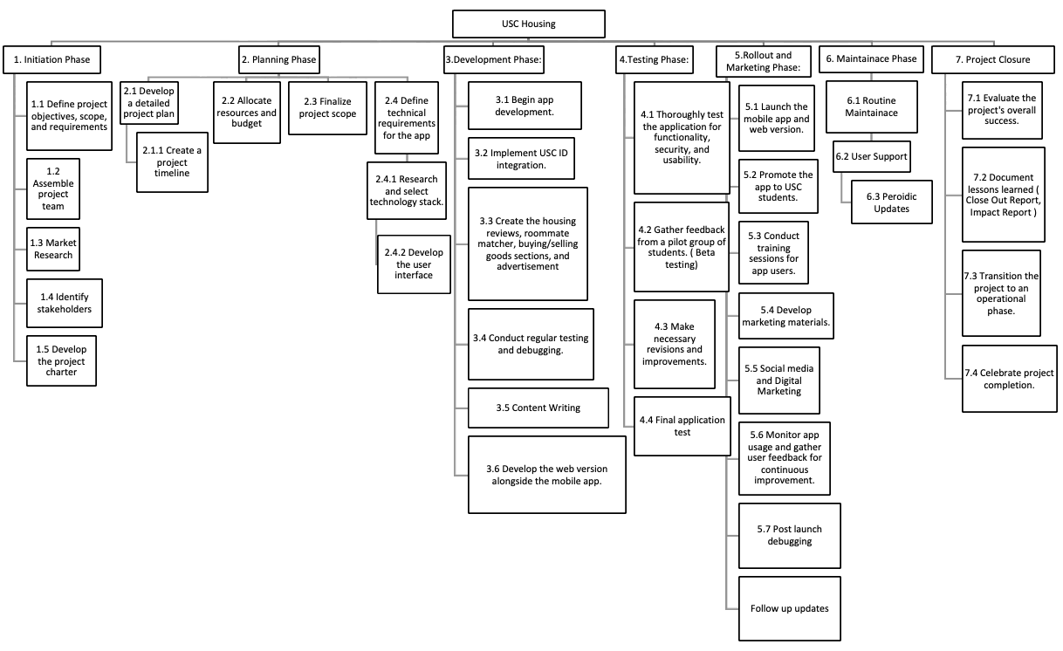

Notes:
RD

Slide 14

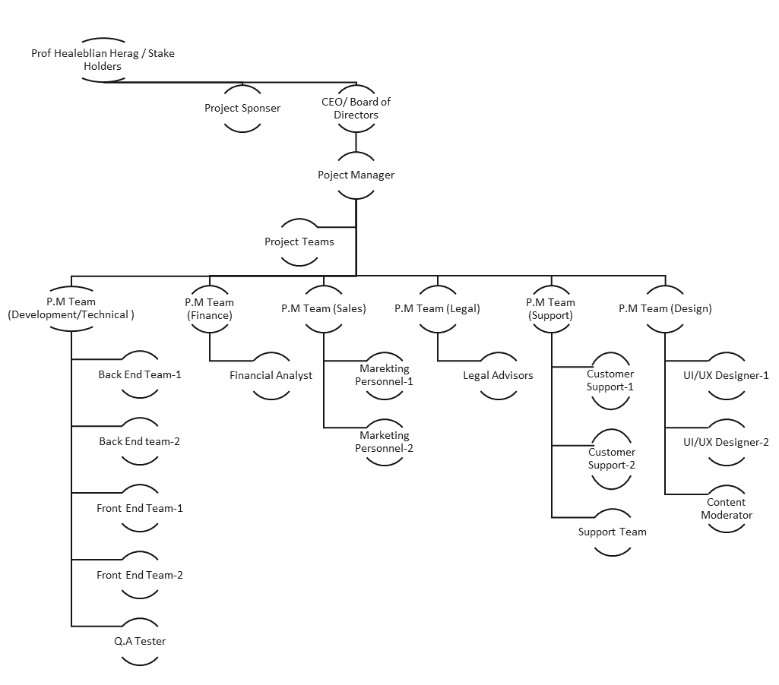
Organizational chart
Notes:
RD

Slide 15
Budget
Notes:
MK

Slide 16

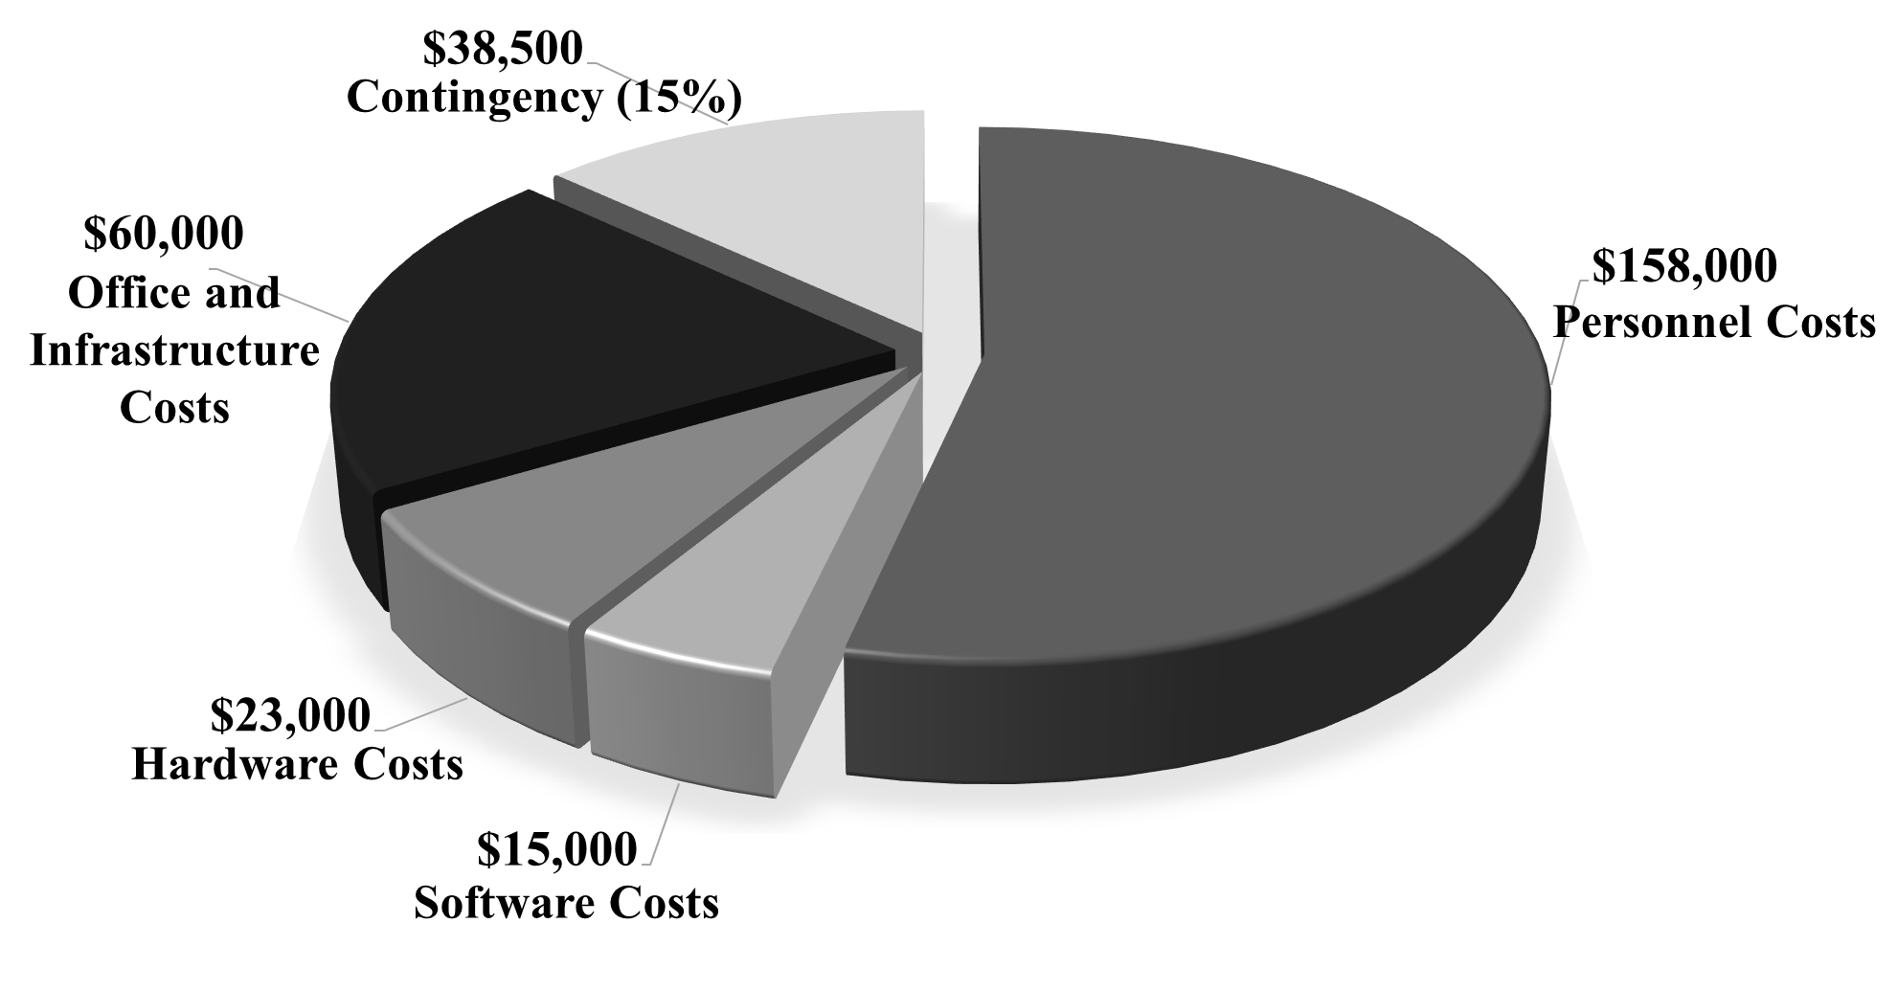
Project Budget Breakdown
The overall project is estimated at $295,000, with a development timeline of approximately 7.4 months
Post-project, operational expenses are anticipated to be $902,000 annually. This encompasses full-time staff salaries, office rent, and various ongoing expenses
Notes:
MK

Slide 17
Personnel Costs
-Allocated based on MS Project schedule.
-Hourly wages set at a lower scale for cost efficiency.
-Modest project management compensation for cost-effectiveness and team well-being.
Office and Infrastructure
-Covers office space, utilities, furniture, equipment, and business insurance.
-Modest-sized office in California suburbs for collaboration.
Software Tools
-Essential tools with a monthly subscription model for flexibility.
-Enhance project management, UI/UX design, customer support, and data security.
Hardware Components
-Costs include laptops, backup devices, and networking equipment.
-Based on current U.S. prices for practical financial considerations.
Project Costs
Notes:
SA

Slide 18
Personnel Operational Cost
-Strategic downsizing post-platform completion to optimize operational expenses.
-Streamlined roles and responsibilities for greater efficiency.
-Fixed annual salaries introduced for consistent compensation, resulting in an annual personnel cost of $780,000.
Software Costs
-Essential role of each software tool in the DormGrader platform.
-Annual cost of approximately $24,180 for project management, UI/UX design, customer support, network security, and collaboration tools.
-Demonstrates commitment to maintaining platform functionality and efficiency.
Office and Infrastructure
-Consistent ongoing costs for office space, utilities, and insurance.
-Removal of initial hardware and furniture costs in the operational phase.
-Adjusted monthly cost of $3000 for potential new equipment and furniture, reflecting a proactive approach to evolving needs.
Operational Costs
Notes:
SA

Slide 19
Risk &
Change
Notes:
GY

Slide 20
Risk
Data
Breach
Biased
Housing
Reviews
Technical Challenges
Data breaches can result from intentional exploitation of security weaknesses or accidental exposure of sensitive data, either through malicious actions or employee errors.
Some students can be biased or influenced by the agents to submit dishonest reviews
The intricacy of the project's technical aspects could potentially lead to a postponement
Notes:
GY

Slide 21
Risk Mitigation
Data
Breach
Biased Housing Reviews
Technical Challenges
Effective data breach prevention requires strong security policies, controlled access, employee training, encryption, and regular audits, incident response planning.
Implement review verification systems and moderation.
Address technical project delays by detailed planning, assembling skilled teams, regular training, frequent progress checks and risk management strategies.
Notes:
GY

Slide 22
OCM PLAN
“With the integration of a Virtual Reality feature and the introduction of specialized roles like VI Specialist, Data Analyst, and Community Manager, alongside a transition to Agile project management, our USC Housing Mobile App undergoes a transformative evolution, fostering collaboration, innovation, responsiveness, productivity, efficiency, data-driven decision-making, user experience elevation, and competitive advantage reinforcement, all while ensuring robust risk management through continuous feedback and iterative development.”
Notes:
DS

Slide 23
OCM
Communication Plan
Organizational Readiness
Stakeholder Engagement Plan
Training and Development Plan
Metrics and Measures for OCM
Notes:
DS

Slide 24
Project Change Controls
Project Changes are inevitable.
Solid plan for project controls.
We need a template for each change.
Change Number | 007
Change Name | Loyalty Program
Requested By | Marketing
Date | 28th Nov, 2023
Description | Loyalty program for giving rewards and badges to loyal users.

Slide 25
Thanks
Do you have any questions?
Notes:
SA

Slide 26





Our team
Sami Andari
Diya Shah
Rhythm Deo
Mihir Kavishwar
Guozheng Yang
Notes:
SA

Slide 27
References
Online home rental market- industry analysis and forecast (2022-2029). MAXIMIZE MARKET RESEARCH. (2023, March 2). https://www.maximizemarketresearch.com/market-report/online-home-rental-market/148639/#:~:text=Forecast%202022%2D2029-,Online%20Home%20Rental%20Market%2D%20Industry,and%20Forecast%20(2022%2D2029)&text=Online%20Home%20Rental%20Market%20size,reaching%20nearly%20US%24%2044.72%20Bn.
$650 8.6 million needs rental Barriers to Success: Housing Insecurity for U.S. College ...HUD USER (.gov)https://www.huduser.gov › insight › insight_2
8.1 M University of Southern California Student Life - US News Best Collegesusnews.comhttps://www.usnews.com › best-colleges › student-life

